Slide 1

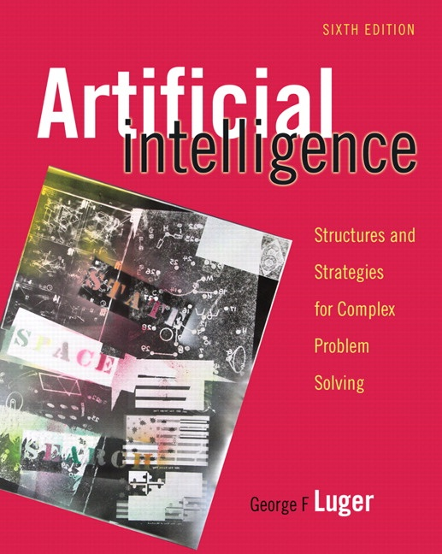
Automated Reasoning
14.0 Introduction to Weak Methods in Theorem Proving
14.1 The General Problem Solver and Difference Tables
14.2 Resolution Theorem Proving
14.3 PROLOG and Automated Reasoning
14.4 Further Issues in Automated Reasoning
14.5 Epilogue and References
14.6 Exercises
George F Luger
ARTIFICIAL INTELLIGENCE 6th edition
Structures and Strategies for Complex Problem Solving
Luger: Artificial Intelligence, 6th edition. © Pearson Education Limited, 2009
1

Slide 2
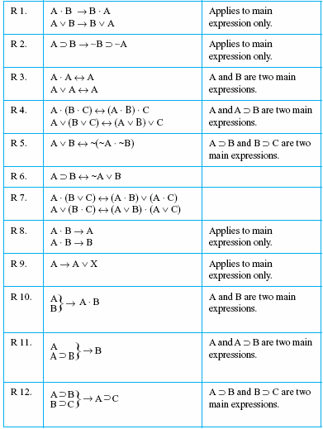
Fig 14.1a Transformation rules for logic problems, from Newell and Simon (1961).
Luger: Artificial Intelligence, 6th edition. © Pearson Education Limited, 2009
2

Slide 3
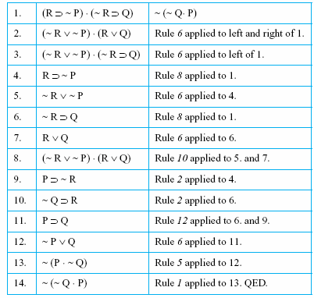
Fig 14.1b A proof of a theorem in propositional calculus, from Newell and Simon (1961).
Luger: Artificial Intelligence, 6th edition. © Pearson Education Limited, 2009
3

Slide 4
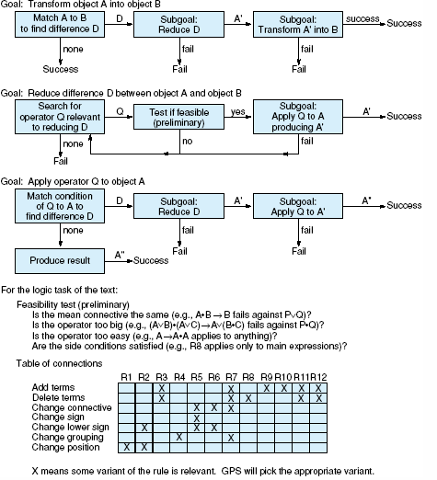
Fig 14.2 Flow chart and difference reduction table for the General Problem Solver, from Newell and Simon (1963b).
Luger: Artificial Intelligence, 6th edition. © Pearson Education Limited, 2009
4

Slide 5
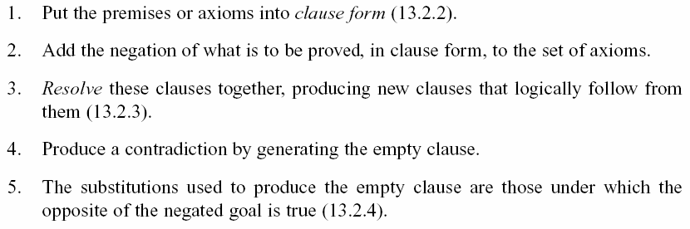
Resolution refutation proofs involve the following steps:
Luger: Artificial Intelligence, 6th edition. © Pearson Education Limited, 2009
5

Slide 6
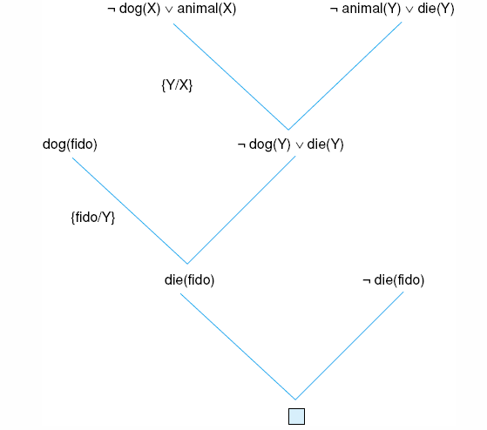
Fig 14.3 Resolution proof for the “dead dog” problem.
Luger: Artificial Intelligence, 6th edition. © Pearson Education Limited, 2009
6

Slide 7
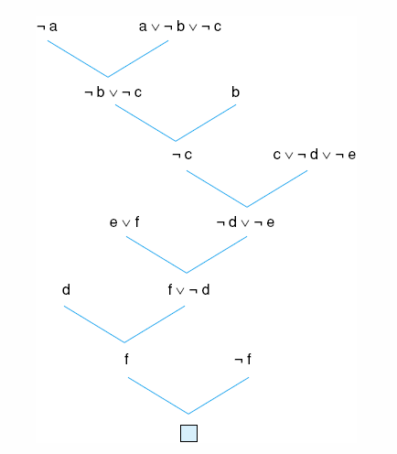
Fig 14.4 One resolution proof for an example from the propositional calculus.
Luger: Artificial Intelligence, 6th edition. © Pearson Education Limited, 2009
7

Slide 8
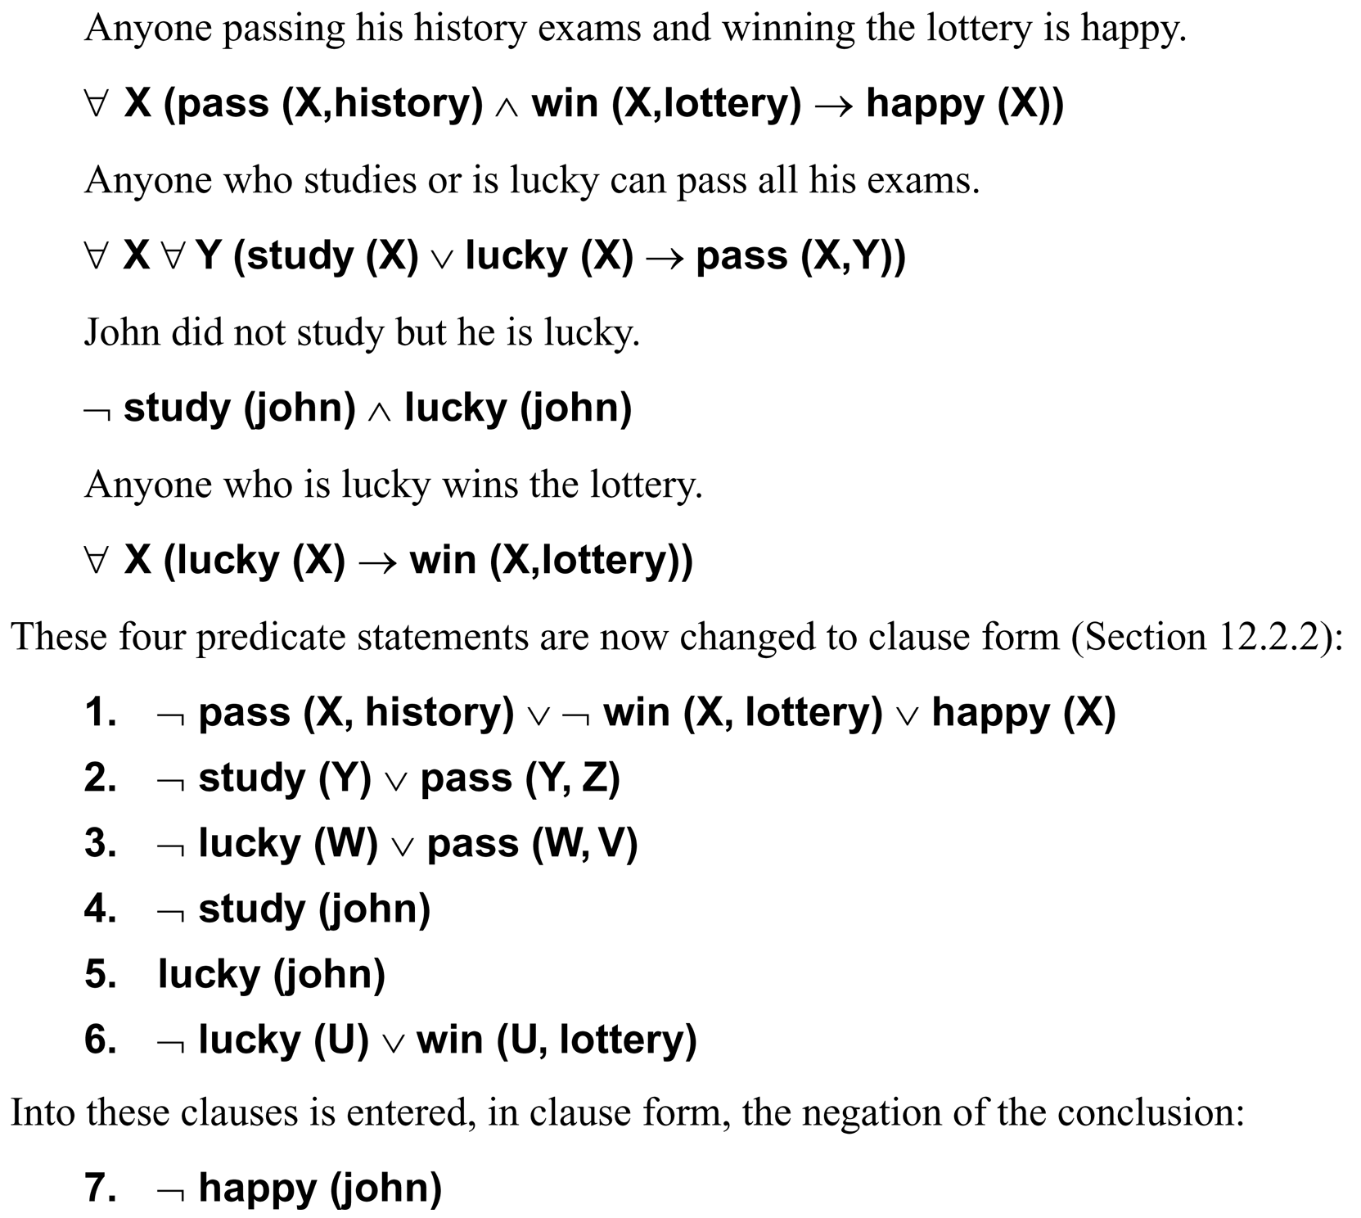
Luger: Artificial Intelligence, 6th edition. © Pearson Education Limited, 2009
8

Slide 9
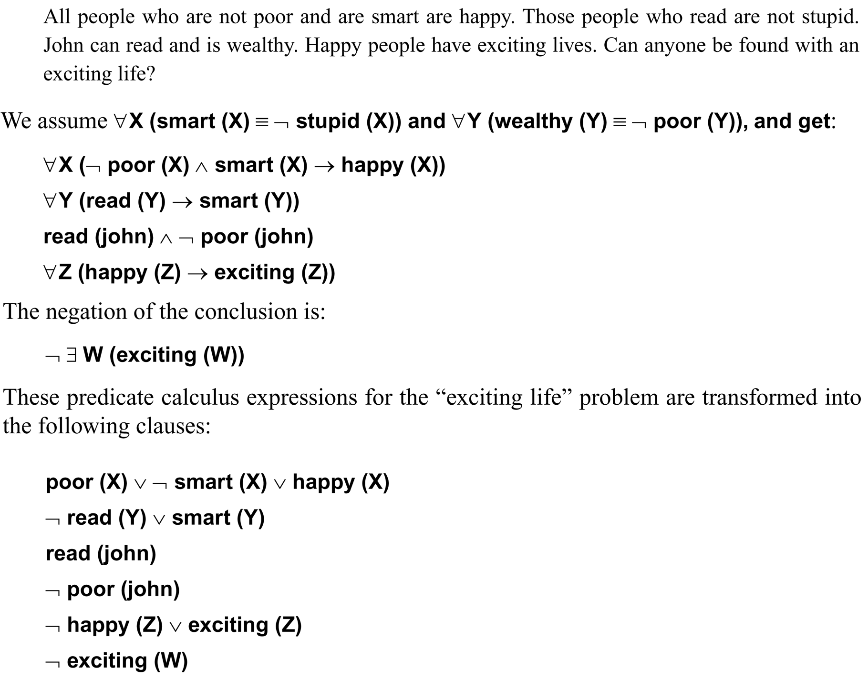
Luger: Artificial Intelligence, 6th edition. © Pearson Education Limited, 2009
9

Slide 10
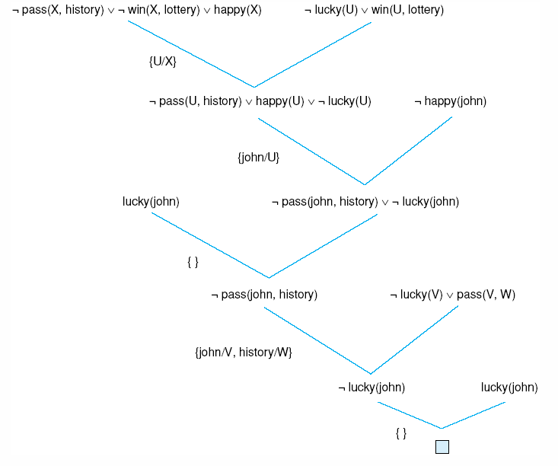
Fig 14.5 One refutation for the “happy student” problem.
Luger: Artificial Intelligence, 6th edition. © Pearson Education Limited, 2009
10

Slide 11
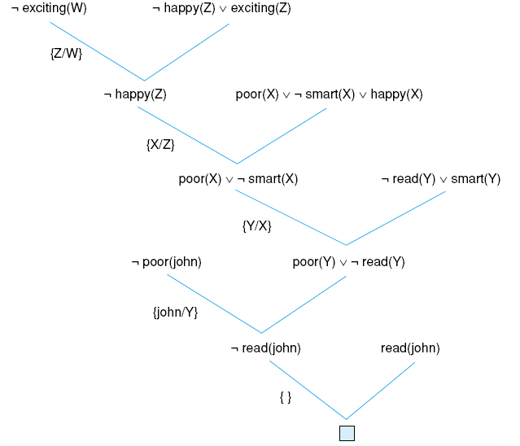
Fig 14.6 Resolution proof for the “exciting life” problem.
Luger: Artificial Intelligence, 6th edition. © Pearson Education Limited, 2009
11

Slide 12
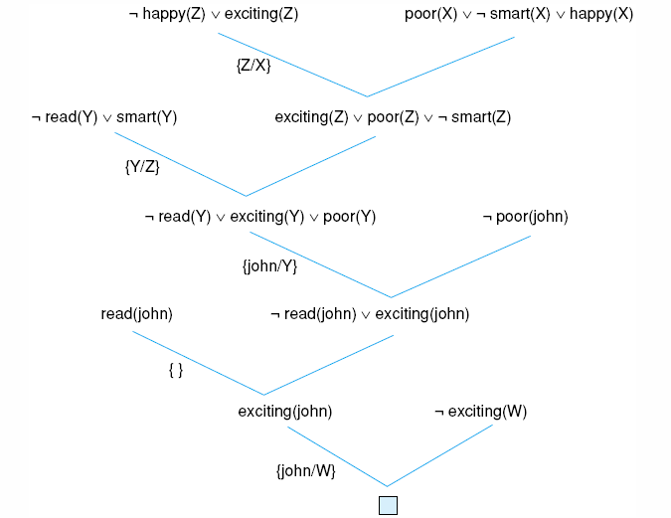
Fig 14.7 another resolution refutation for the example of Fig 14.6.
Luger: Artificial Intelligence, 6th edition. © Pearson Education Limited, 2009
12

Slide 13
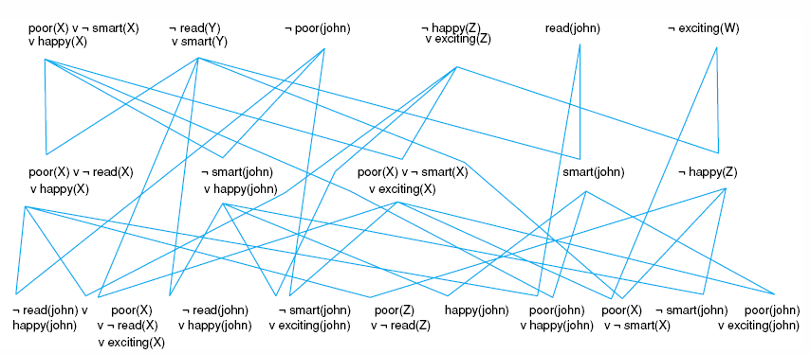
Fig 14.8 Complete state space for the “exciting life” problem generated by breadth-first search (to two levels).
Luger: Artificial Intelligence, 6th edition. © Pearson Education Limited, 2009
14

Slide 14
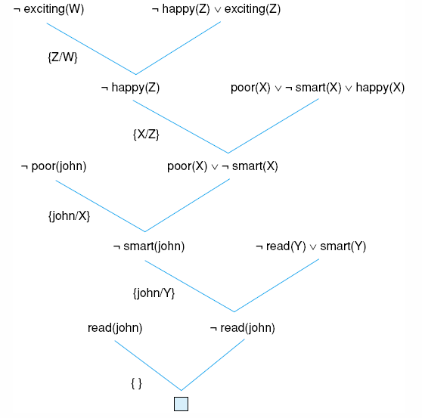
Fig 14.9 Using the unit preference strategy on the “exciting life” problem.
Luger: Artificial Intelligence, 6th edition. © Pearson Education Limited, 2009
14

Slide 15
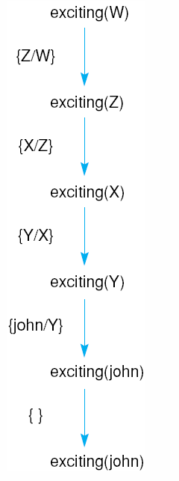
Fig 14.10 Unification substitutions of Fig 14.6 applied to the original query.
Luger: Artificial Intelligence, 6th edition. © Pearson Education Limited, 2009
15

Slide 16
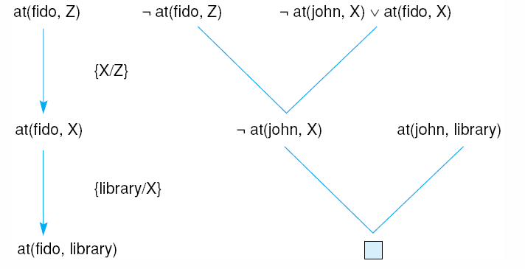
Fig 14.11 Answer extraction process on the “finding fido” problem.
Luger: Artificial Intelligence, 6th edition. © Pearson Education Limited, 2009
16

Slide 17
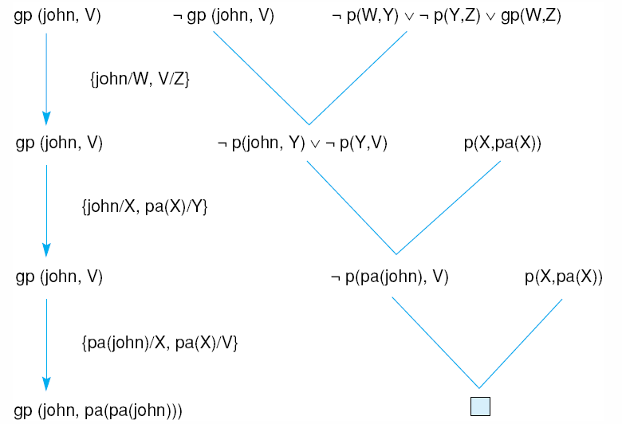
Fig 14.12 Skolemization as part of the answer extraction process.
Luger: Artificial Intelligence, 6th edition. © Pearson Education Limited, 2009
17

Slide 18
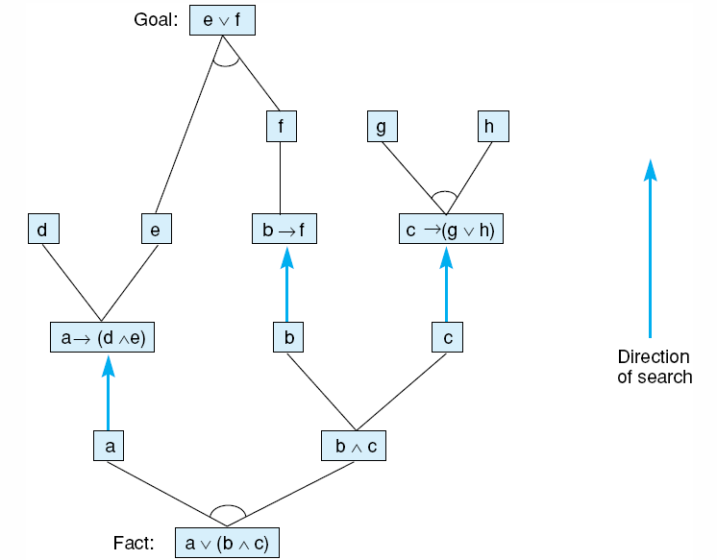
Fig 14.13 Data-driven reasoning with n and/or graph in the propositional calculus
Luger: Artificial Intelligence, 6th edition. © Pearson Education Limited, 2009
18

Slide 19
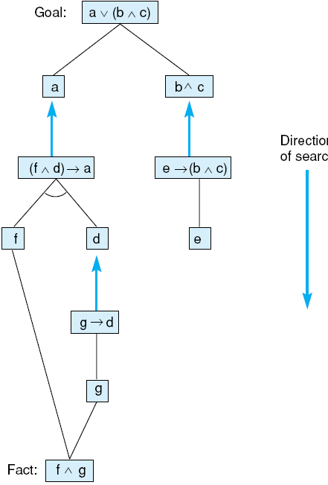
Fig 14.14 Goal-driven reasoning with an and/or graph in the propositional calculus.
Luger: Artificial Intelligence, 6th edition. © Pearson Education Limited, 2009
19

Slide 20
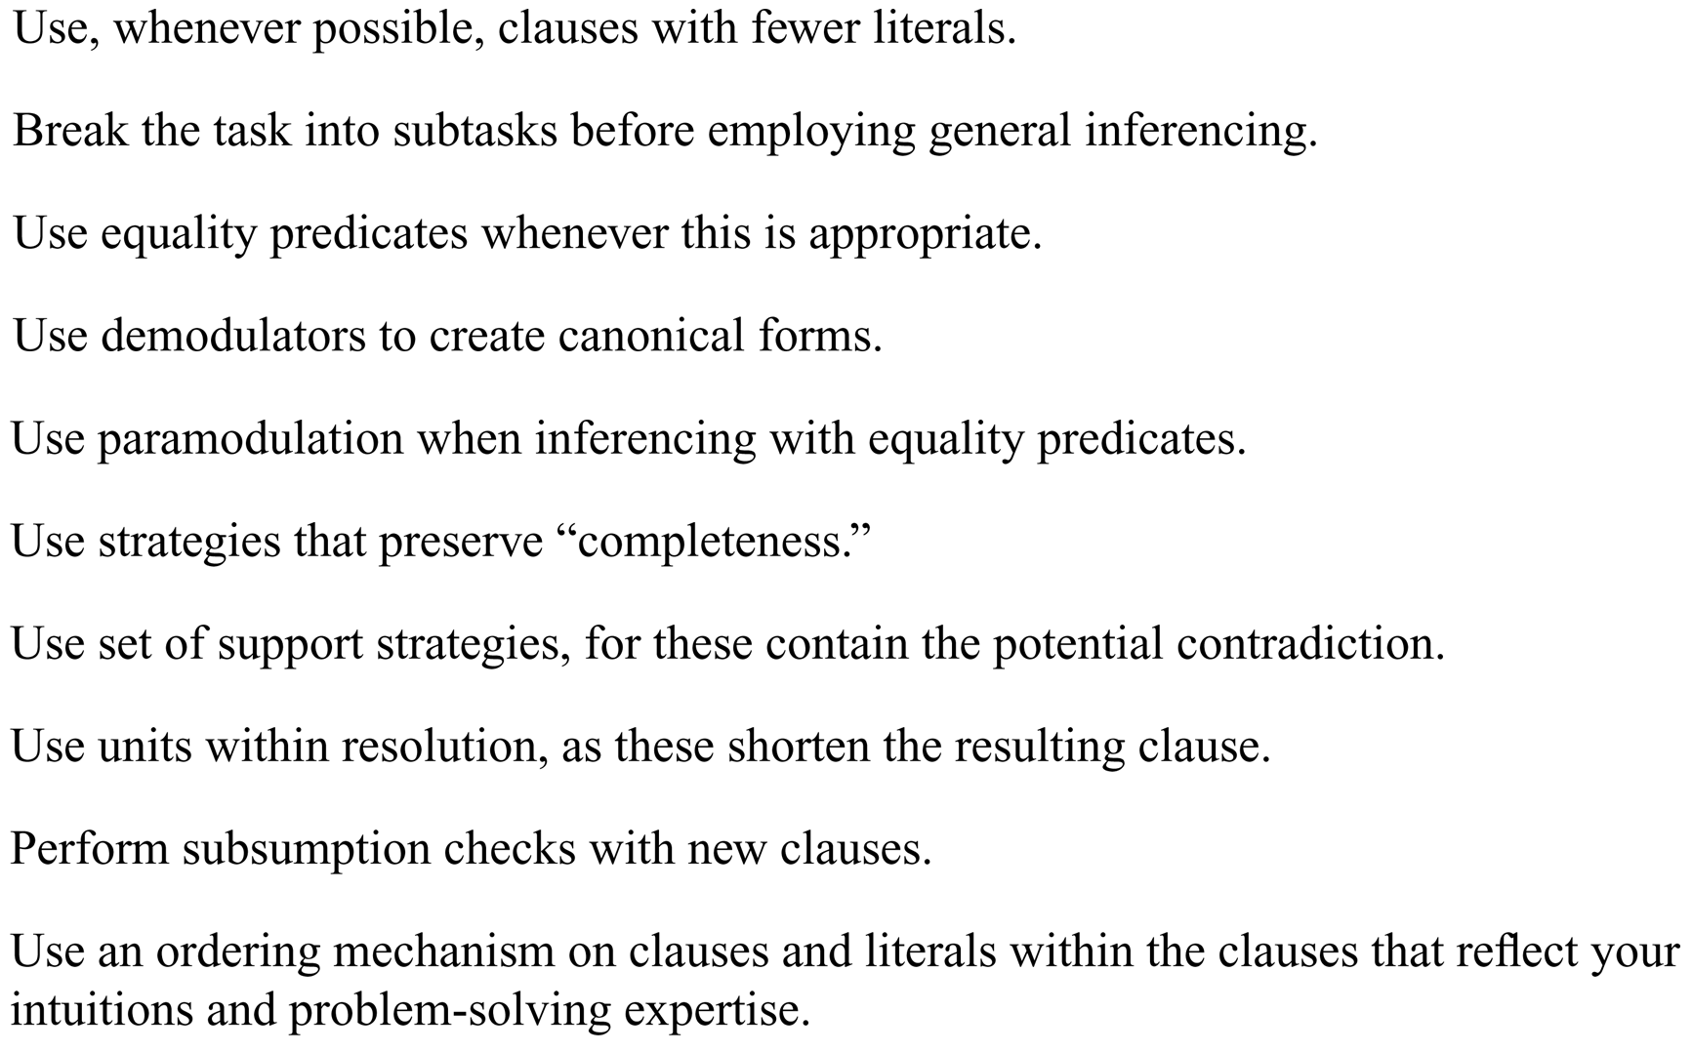
Luger: Artificial Intelligence, 6th edition. © Pearson Education Limited, 2009
20

